Slide 1
Credit default prediction
Guanghong Yi

Slide 2
background and the story
2006, Taiwan Financial Supervisory Commission
$4.93 billion worth of bad loans
$3.49 billion from credit card loans
$1.44 billion from cash card loans
Taiwan Credit Crisis

Slide 3
Data
Amount: 30000
Categories:
ID
Limit Balance
Sex
Education
Marriage
Age
Repayment Status (from April to September 2005)
Amount of bill statement (from April to September 2005)
Amount of previous payment (from April to September 2005)
Default payment next month

Slide 4
PRIMARY GOALS
Predict default payment next month

Slide 5
Dataset detail

Slide 6
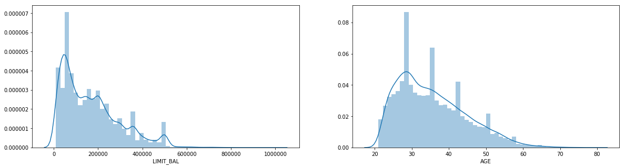
Dataset detail

Slide 7
Dataset detail

Slide 8
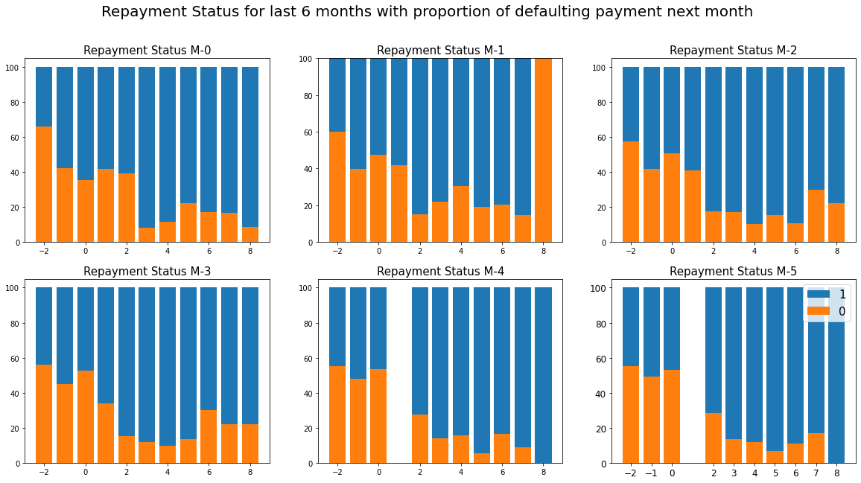
Dataset detail

Slide 9
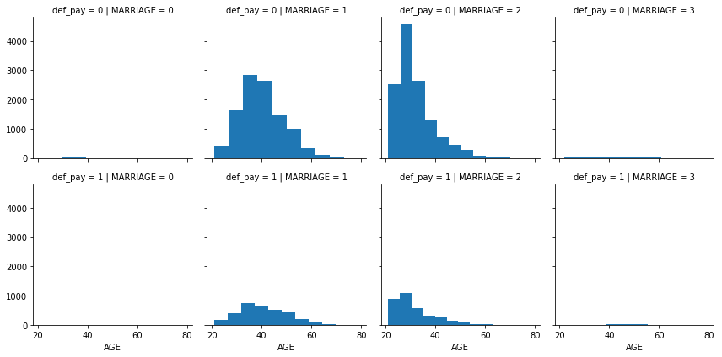
Dataset detail

Slide 10
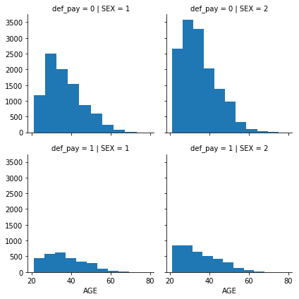
Dataset detail

Slide 11
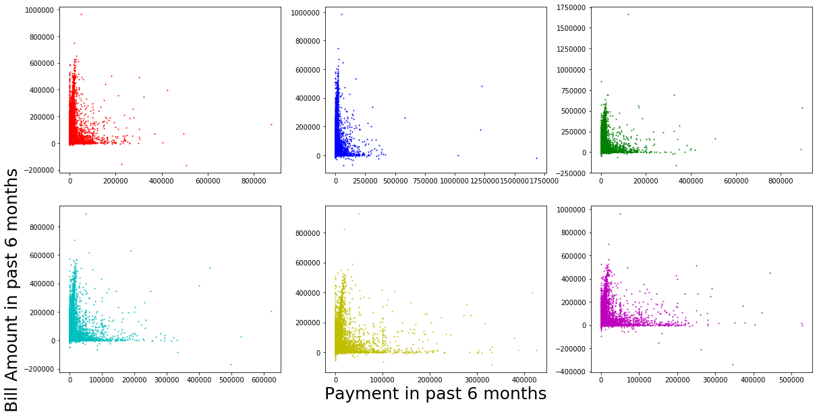
Dataset detail

Slide 12
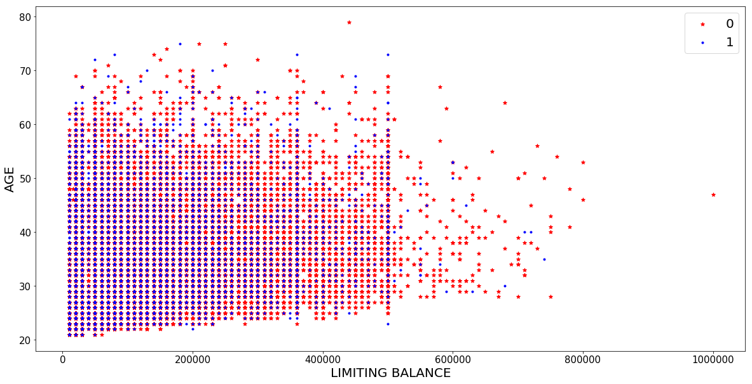
Dataset detail

Slide 13
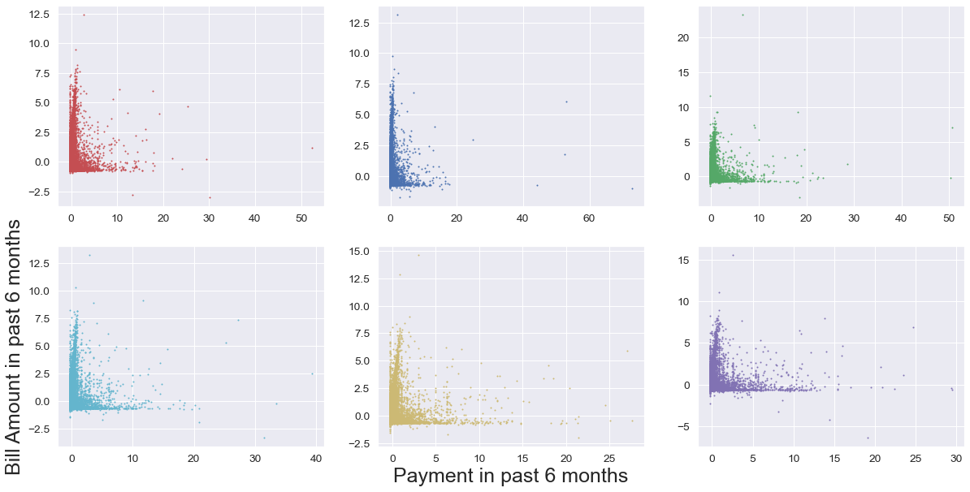
Standardization
Feature Scaling:
Scalar = StandardScaler()
X_train_scale = scaler.fit_transform(X_train)
X_test_scale = scaler.transform(X_test)
X_train = pd.Dataframe(X_train_scale, columns = X_train.columns)
X_test = pd.Dataframe(X_test_scale, columns = X_test.columns)

Slide 14
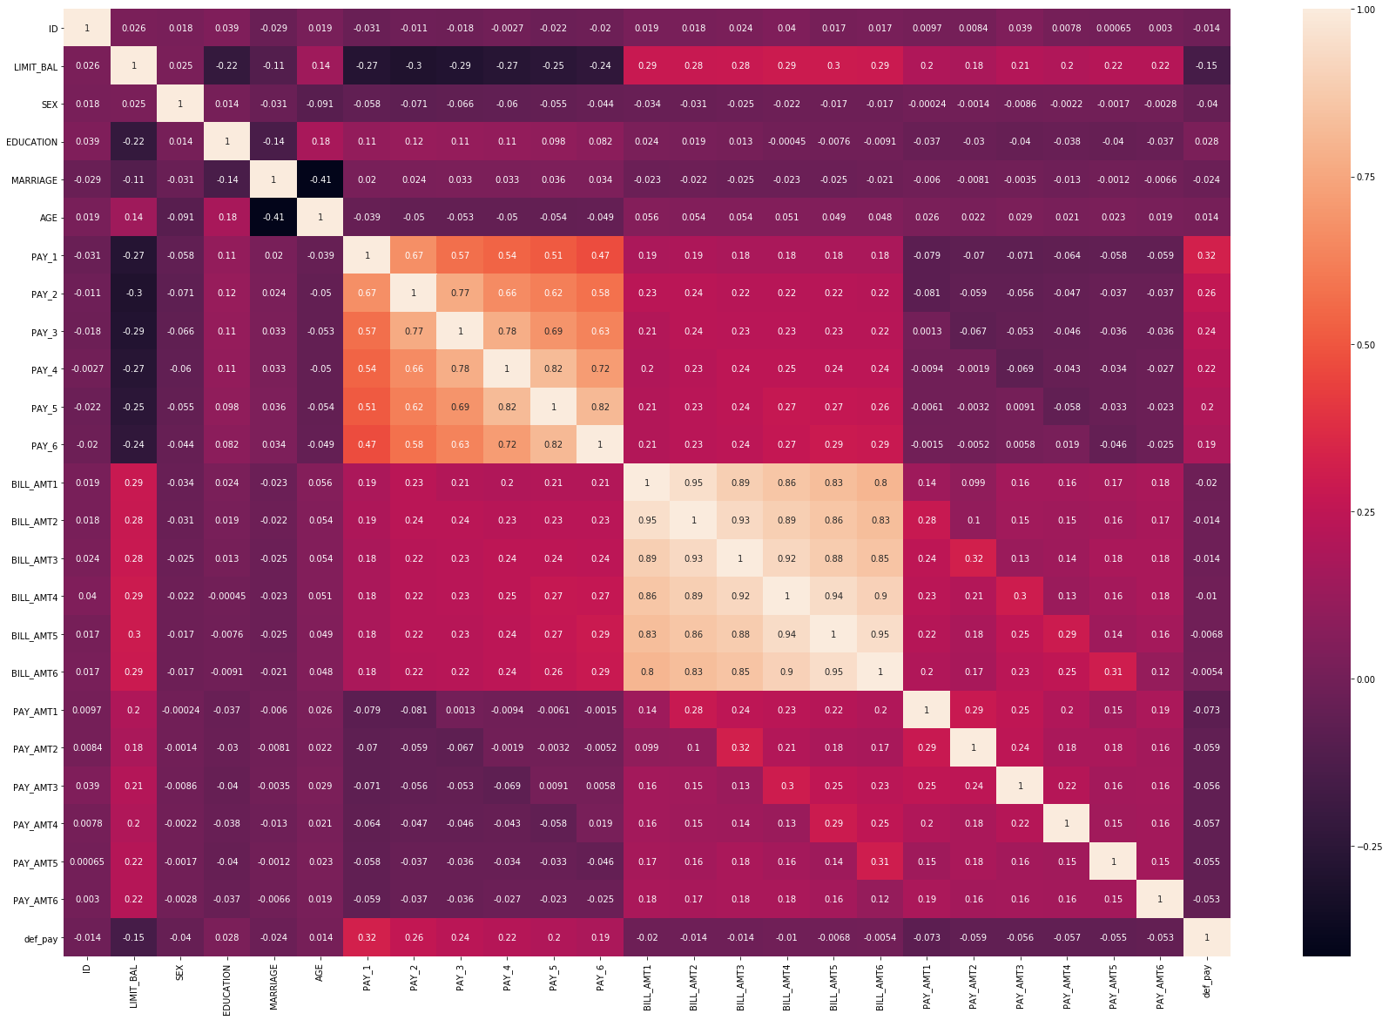
Correlation matrix

Slide 15
algorithms
Logistic Regression
K Neighbors
Random Forest

Slide 16
Logistic regression
df_X = defaulters.drop(['default payment next month','AGE_BIN'], axis=1)
df_y = defaulters['default payment next month']
Precision Recall F1-Score Support
0 1.0 0.78 0.88 5998
1 0.0 0.00 0.00 2
Accuracy 0.78 6000
Macro average 0.5 0.39 0.44 6000
Weighted average 1.0 0.78 0.88 6000
Accuracy Score for model: 0.780166666666667

Slide 17
Logistic regression
df_X = defaulters. [[‘SEX’ , ‘MARRIAGE’ , ‘AGE’ , ‘BILL_AMT1’ , ‘Education’ , ‘PAY_1’]]
df_y = defaulters['default payment next month']
Precision Recall F1-Score Support
0 0.99 0.79 0.88 5784
1 0.11 0.70 0.18 216
Accuracy 0.79 6000
Macro average 0.55 0.39 0.54 6000
Weighted average 0.95 0.78 0.86 6000
Accuracy Score for model: 0.792

Slide 18
K Neighbors
df_X = defaulters. [[‘SEX’ , ‘MARRIAGE’ , ‘AGE’ , ‘BILL_AMT1’ , ‘Education’ , ‘PAY_1’]]
df_y = defaulters['default payment next month']
Precision Recall F1-Score Support
0 0.78 0.93 0.88 5784
1 0.29 0.10 0.18 216
Accuracy 0.74 6000
Macro average 0.54 0.52 0.50 6000
Weighted average 0.67 0.74 0.69 6000
Accuracy Score for model: 0.744

Slide 19
Random forest
df_X = defaulters. [[‘SEX’ , ‘MARRIAGE’ , ‘AGE’ , ‘BILL_AMT1’ , ‘Education’ , ‘PAY_1’]]
df_y = defaulters['default payment next month']
Precision Recall F1-Score Support
0 0.83 0.90 0.86 4663
1 0.50 0.36 0.48 1337
Accuracy 0.74 6000
Macro average 0.67 0.63 0.64 6000
Weighted average 0.76 0.78 0.76 6000
Accuracy Score for model: 0.7785

Slide 21
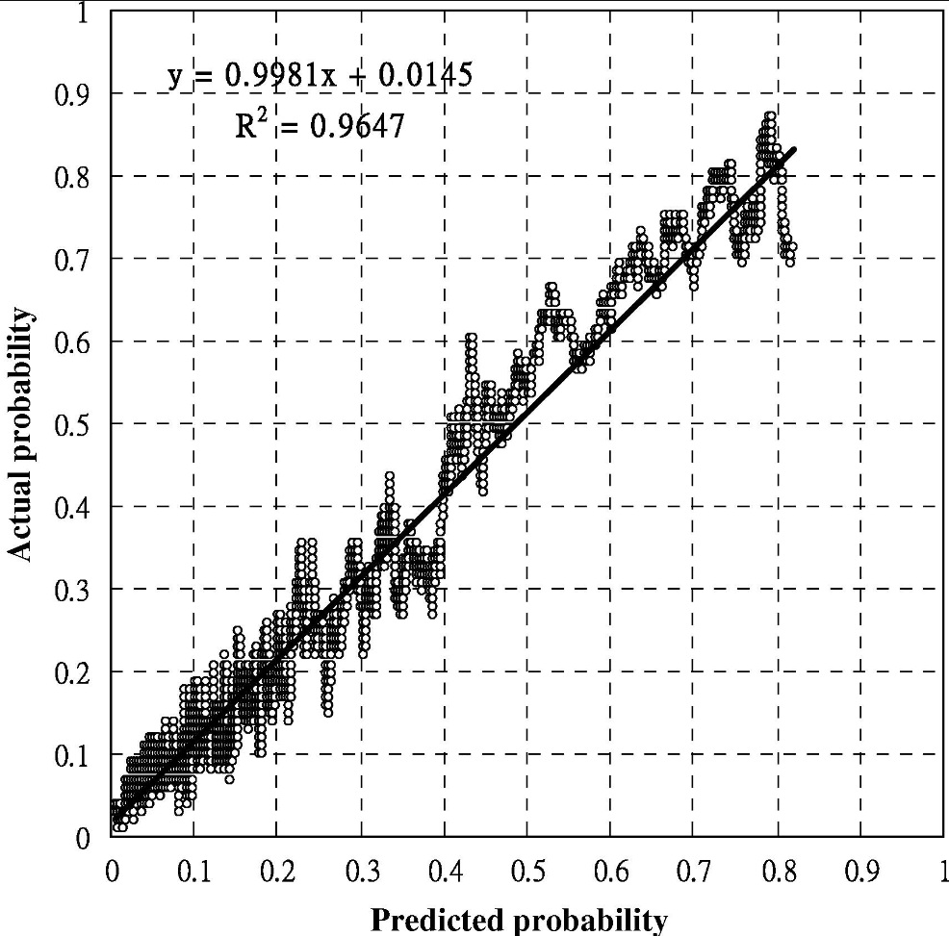
Yeh, & Lien, C. (2009). The comparisons of data mining techniques for the predictive accuracy of probability of default of credit card clients. Expert Systems with Applications, 36(2), 2473–2480. https://doi.org/10.1016/j.eswa.2007.12.020

Slide 22
THANK YOU!!!
Guanghong Yi
Guanghong.yi@uconn.edu

